Slide 1
Lab #8
KestrelSAT Capstone
Project Guidance

Slide 2
Authorized Resources
Lab activities & lab presentation are team effort
Any non-human resource.
  Generative AI Level 4 Allowed
GenAI Level 4: Cadets may use GenAI to develop drafts, outlines, or provide suggested revisions to their drafts, but they must critically evaluate, revise, and take ownership of the content. Submitted work should reflect the cadet’s understanding, not unedited AI output. This use of GenAI must be clearly documented as instructed, specifying how GenAI contributed and what the cadet did to revise or evaluate that content.
Any human for: brainstorming / advice / limited troubleshooting.
  Non-group members cannot write code for you or perform any substantive amount of work.
Resources
Overview
Reqts
Method
Milestones
Ideas

Slide 3
Overview
Resources
Overview
Reqts
Method
Milestones
Ideas
Lab #8 (“KestrelSAT Capstone”) is the culminating lab experience of Astro 331, providing cadets a capstone-like experience where they have autonomy to engineer and create.
The overall goal of this lab is for your team to design, build, test, and iterate a new KestrelSAT subsystem (or augment/combine current subsystems).
  Accordingly, the scope and expectations of this lab are much greater than previous labs.
Teams are expected to utilize modern engineering tools (e.g. agentic AI) to move faster and farther than they could otherwise.
  Using these tools does not absolve you of deeply understanding the engineering that goes into this lab.

Slide 4
Requirements
Resources
Overview
Reqts
Method
Milestones
Ideas
KestrelSAT Capstone is a “choose your own adventure” experience.
  → Your team gets to decide what you will accomplish.
To scope your project, you must initially generate:
  At least three (3) verifiable primary (threshold) requirements
    Unless there are exceptional circumstances coordinated with your instructor, these requirements must be achieved by your final presentation for full credit.
  At least one (1) verifiable stretch (objective) requirement
    This requirement(s) is desirable, but dispensable if constraints arise.
    Completing this requirement(s) will be considered highly for final grading.
You will get feedback on your draft requirements from your Proposal turn-in, and they must be solidified by your Preliminary Review.

Slide 5
Method
SPECIFY
GENERATE
IMPLEMENT
ADJUDICATE
Verifiable requirements
Agent proposes a design
Trusted tool(s) make it real
Engineer owns the call
Resources
Overview
Reqts
Method
Milestones
Ideas
ITERATE
You must produce a Git Repository containing all your work for this project.
You can start by forking (copying) one of the previous KestrelSAT labs.
The Github link for this repo must be provided to your instructor before the Final Presentation.
It is highly recommended that you leverage agentic AI for at least the coding portion of your work (e.g. Claude Code or ChatGPT Codex).
Expect dedicated instruction on how to do this, but the general workflow for agentic coding is:
  → Create Repo for your project and push it to Github
  → Open a new session in Claude Code/ChatGPT Codex/other coding agent
  → Connect your repo to the session
  → Work with the agent to generate commits for your project
  → Adjudicate agent work and iterate!

Slide 6
KestrelSAT Capstone Milestones
Resources
Overview
Reqts
Method
Milestones
Ideas
This project has three milestones:
Proposal (due Lsn 19)
Preliminary Data Review (Lsn 23)
Final Presentation + Git Repo (Lsn 31)

Slide 7
Proposal (Due Lsn 19)
Resources
Overview
Reqts
Method
Milestones
Ideas
For the proposal turn-in, use the provided final presentation template and complete the first two sections: Overview and Requirements.
These will become the first two sections of your final presentation.

Slide 8
Preliminary Data Review (Lsn 23)
Resources
Overview
Reqts
Method
Milestones
Ideas
For this review, you will conduct a ~10 min presentation/discussion with your instructor discussing the work you have done so far and your plans to complete requirements by the final presentation date.
No specific format for the review is required, but it must include at least some results/data collected so far.
  Unless pre-coordinated with your instructor, collected data must be presented in a plot(s).
Present your requirements; they must be solidified by this review.
You may conduct a live demo of your work and/or solicit feedback/ask questions to your instructor.

Slide 9
Final Presentation + Git Repo (Lsn 31)
Resources
Overview
Reqts
Method
Milestones
Ideas
The final submittal for this project will include a presentation and submission of your Git repo.
Presentation:
Length: 18-20 mins +5 mins for questions.
See template for additional guidance on what to include.
  Presentations must include copious relevant pictures/plots/video/diagram/etc.
Extra credit will be given if you conduct a successful live demo of your project during your presentation.
Git Repo:
Turn in a link to your repo via email prior to your final presentation day.
Must be well documented and organized. Include all work done for this lab (work not included in the repo but discussed in your presentation will not be considered for grading).

Slide 10
KestrelSAT Capstone Topic Ideas
Resources
Overview
Reqts
Method
Milestones
Ideas
NOTE: Topic ‘goals’ must be converted to verifiable requirements for your proposal turn-in.

Slide 11
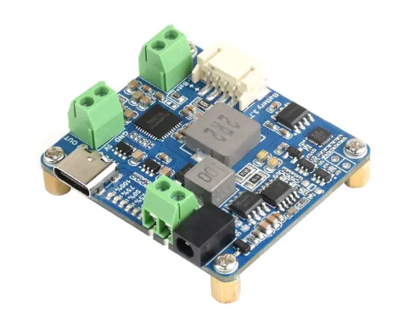
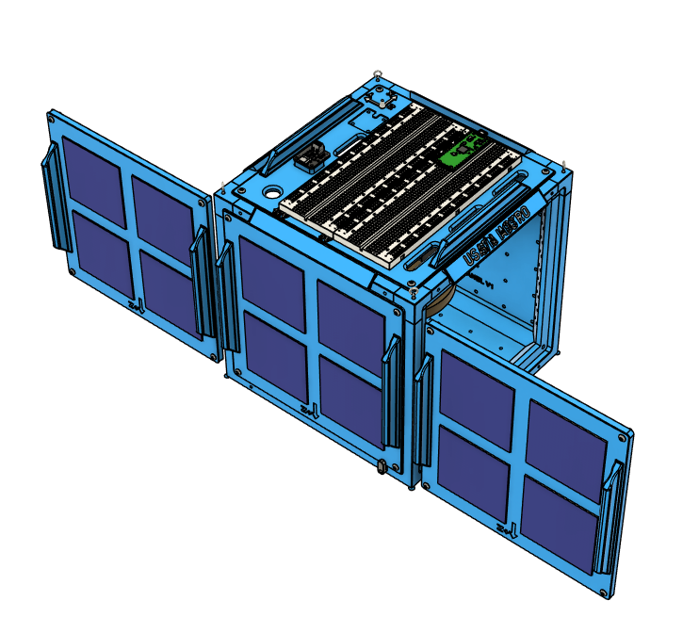
Topic Idea 1: Upgrade EPS
Resources
Overview
Reqts
Method
Milestones
Ideas
Goal ideas:
Add a solar power charge controller to the EPS system of KestrelSAT. Use this controller to charge the onboard battery.
Add solar cells as required to provide enough power to the controller to charge the onboard battery.
Record the voltage and current output from the charge controller using the onboard INA219 and determine how much charge the battery received.
Design a 3D Printed Bracket mount the additional solar cells to KestrelSAT.
Stretch Goal ideas:
Show that KestrelSAT is power positive in sunlight using telemetry signals over XBee.

Slide 12
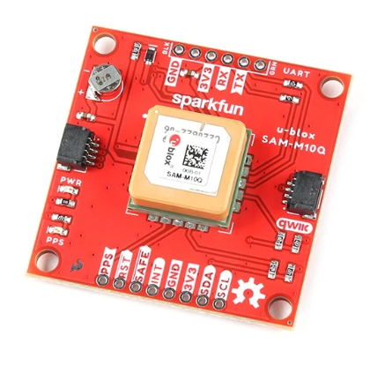
Topic Idea 2: Add GNSS Receiver
Resources
Overview
Reqts
Method
Milestones
Ideas
Goal ideas:
Add a GNSS receiver to KestrelSAT and record the following data:
    Latitude / Longitude
    Height above Ellipsoid
    3D velocity
    Number of Satellites in View
    DOP
Record the GNSS data onboard KestrelSAT SD card, and send it over Xbee connection. Record Ground Station RSSI for each packet sent.
Conduct a simulated s/c fly-by, recording the location and RSSI over time. Plot and analyze the trajectory and RSSI.
Stretch goal ideas:
Get and examine Az/El and C/N0 for GNSS Sats in view.
SparkFun GPS Breakout - Chip Antenna, SAM-M10Q (Qwiic)

Slide 13
Topic Idea 3: Closed-Loop Control Using Reaction Wheel
Resources
Overview
Reqts
Method
Milestones
Ideas
Goal ideas:
Implement a control algorithm that uses the reaction wheel to stabilize KestrelSAT’s attitude about the Z-axis to a particular attitude (e.g. slew magnetic heading or track sun).
Create a basic simulation (recommend Simulink) and demonstrate your controller in simulation in addition to hardware.
Dynamically update heading setpoint over Xbee connection.
Stretch goal ideas:
Implement a complimentary filter sensor fusion algorithm to combine gyro heading and magnetometer heading.
Add a small PC fan to simulate a disturbance (e.g. a stuck thruster) and examine if/how the control system can overcome this disturbance.

Slide 14
Topic Idea 4: Send Image over XBee Connection
Resources
Overview
Reqts
Method
Milestones
Ideas
Goal ideas:
Transfer an image captured by the onboard camera over the XBee connection to the ground station.
Upgrade the KestrelSAT GUI to receive and display the transmitted picture.
Stretch goal ideas:
Also save images captured by the onboard camera to SD.
Demonstrate sending an image over XBee across T-Zo (use directional antennas)

Slide 15
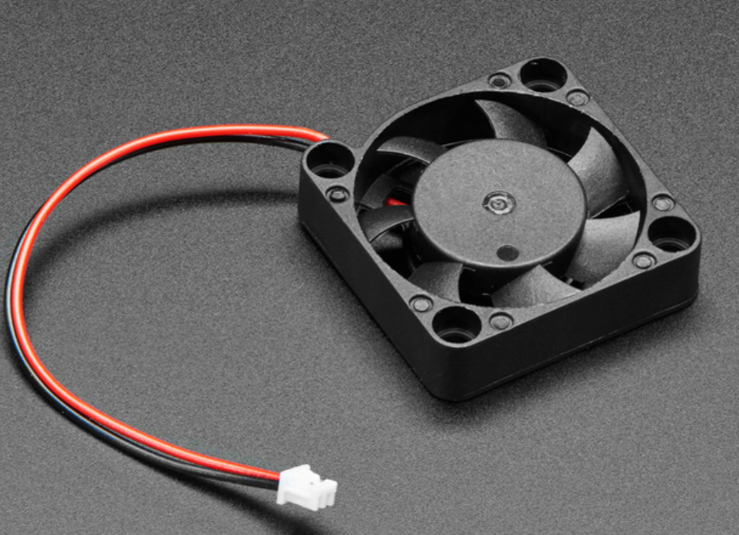
Topic Idea 5: Add Thrusters
Resources
Overview
Reqts
Method
Milestones
Ideas
Goal ideas:
Design and 3D print a mount for two small PC fans to attaches to KestrelSAT and act as thrusters.
Examine maneuvering KestrelSAT with these thrusters. Experimentally determine the amount of thrust produced by the thrusters. Demonstrate open loop slew maneuver using the thrusters.
Create a basic simulation (recommend Simulink) and demonstrate your controller in simulation in addition to hardware.
Examine momentum dumping of the RW using the thrusters.
Stretch goal ideas:
(1) Develop a closed loop controller that uses the thrusters (and RW if desired) to control KestrelSAT attitude to a specific heading.

Slide 16
Topic Idea 6: Integrate Magnetorquer
Resources
Overview
Reqts
Method
Milestones
Ideas
Goal Ideas:
Understand theory of magnetorquers and design/build one (or use ones in lab)
Attach to KestrelSAT and demonstrate slew maneuver using it
Stretch Goal Ideas:
Demonstrate momentum dumping of reaction wheel using magnetorquer

Slide 17
Topic Idea 7: Create TCS Lab
Resources
Overview
Reqts
Method
Milestones
Ideas
Goal Ideas:
Design a KestrelSAT lab demonstrating TCS topics
Incorporate thermocouples to measure temperature of parts
Create lab procedures and documentation
Stretch Goal Ideas:
Create an actively controlled TCS (e.g. radiator with louvers)

Slide 18
Other ideas (discuss with instructor)
Resources
Overview
Reqts
Method
Milestones
Ideas
Design an improved sun sensor and creation a sensor fusion algorithm to combine it with gyro data
  Design PCB for sun sensor
Real-time calibration of magnetometer
3DOF attitude estimation using gyro
Antenna radiation pattern characterization
Sun tracking solar array
Vibe test KestrelSAT

